Slide 1

IN432
Advanced Web Programming

Slide 2
Lecture Outline:
Domain name, hosting, DNS and search engine optimization.
Creating your first .html file
Main elements: DOCTYPE, html, head and body sections.
Heading elements, paragraph, division, span, comment.
Formatting elements: italic, underline, bold, small, superscript, subscript, markup, strikethrough, quote, blockquote, pre-formatted text, line break, horizontal break, tooltip (title attribute),Special characters: non-breaking space, copyright… &nbsp; &cop
Lists: unordered list, ordered list, description list, nested lists, changing list style type in html.
Image with specification of alternative text, height and width in html.

Slide 3
A Simple HTML Document / Explained
The <!DOCTYPE html> declaration defines that this document is an HTML5 document
The <html> element is the root element of an HTML page
The <head> element contains meta information about the HTML page
The <title> element specifies a title for the HTML page (which is shown in the browser's title bar or in the page's tab)
The <body> element defines the document's body, and is a container for all the visible contents, such as headings, paragraphs, images, hyperlinks, tables, lists, etc.
The <h1> element defines a large heading
The <p> element defines a paragraph

Slide 4
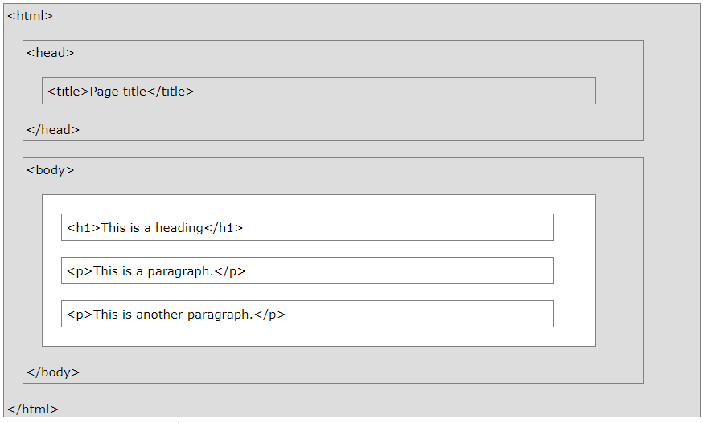
Structure of a Web Page

Slide 5
Structure of a Web Page
All Web pages share a common structure
All Web pages should contain a pair of <HTML>, <HEAD>, <TITLE>, and <BODY> tags
<HTML>
<HEAD>
<TITLE> Example </TITLE>
</HEAD>
<BODY>
This is where you would include the text and images on your Web page.
</BODY>
</HTML>

Slide 6
3. HTML Elements & Tags
The essence of HTML programming is tags
A tag is a keyword enclosed by angle brackets ( Example: <I> )
There are opening and closing tags for many but not all tags;
The affected text is between the two tags
The opening and closing tags use the same command except the closing tag contains and additional forward slash /
For example, the expression <B> Warning </B> would cause the word ‘Warning’ to appear in bold face on a Web page

Slide 7
3. HTML Elements & Tags
An HTML element is defined by a start tag, some content, and an end tag:
<tagname>Content goes here...</tagname>
The HTML element is everything from the start tag to the end tag:
<h1>My First Heading</h1>
<p>My first paragraph.</p>

Slide 8
3. HTML Elements & Tags
Whenever you have HTML tags within other HTML tags, you must close the nearest tag first
Example:
  <H1> <I> The Nation </I> </H1>

Slide 9
The <TITLE> Tag
Choose the title of your Web page carefully; The title of a Web page determines its ranking in certain search engines
The title will also appear on Favorite lists, History lists, and Bookmark lists to identify your page

Slide 10
Text Formatting Tags
<B> Bold Face </B>
<I> Italics </I>
<U> Underline </U>
<P> New Paragraph </P>
<BR> Next Line
Description | Tag
Defines bold text | <b>
Defines big text | <big>
Defines emphasized text | <em>
Defines italic text | <i>
Defines underline text | <U>
Defines small text | <small>
Defines strong text | <strong>
Defines subscripted text | <sub>
Defines superscripted text | <sup>

Slide 11
Changing the Font
The expression <FONT FACE = “fontname”> … </FONT> can be used to change the font of the enclosed text
To change the size of text use the expression <FONT SIZE=n> …. </FONT> where n is a number between 1 and 7
To change the color, use <FONT COLOR=“red”>…. </FONT>; The color can also be defined using hexadecimal representation ( Example: #ffffff )
These attributes can be combined to change the font, size, and color of the text all at once; For example, <FONT SIZE=4 FACE=“Courier” COLOR=“red”> …. </FONT>

Slide 12
Headings
Web pages are typically organized into sections with headings; To create a heading use the expression <Hn>….</Hn> where n is a number between 1 and 7
In this case, the 1 corresponds to the largest size heading while the 7 corresponds to the smallest size

Slide 13
HTML Text margins
A <blockquote> tag is used to format a text by indenting , or increasing the margins on the right and left sides of the blockquote text
Example
<p > this is a regular text </p>
<blockquote> the text in this paragraph is blockquote. Notice how the text indents on the left side of the page , and wraps when it encounters the right margins
</blockquote>

Slide 14
Aligning Text
The ALIGN attribute can be inserted in the <P> and <Hn> tags to right justify, center, or left justify the text
For example, <H1 ALIGN=CENTER> The New York Times </H1> would create a centered heading of the largest size

Slide 15
HTML Rules (Lines)
The <hr /> tag is used to create an horizontal rule (line).
Example
<p>This is a paragraph</p>
<hr>
<p>This is a paragraph</p>
<hr/>
<hr width = 50% size = 7 noshade>

Slide 16
HTML symbols & special characters
Displaying certain symbol in a web page requires to specify the numeric value that represents the symbol .
Example
<p> the copyright example &#169; </p>
OR
<p> the copyright example &copy </p>
Result : the copyright example ©

Slide 17
Comment Statements
Comment statements are notes in the HTML code that explain the important features of the code
The comments do not appear on the Web page itself but are a useful reference to the author of the page and other programmers
To create a comment statement use the <!-- …. --> tags

Slide 18
Page Formatting
To define the background color, use the BGCOLOR attribute in the <BODY> tag
To define the text color, use the TEXT attribute in the <BODY> tag
To define the size of the text, type <BASEFONT SIZE=n>

Slide 19
Example
<HTML>
<HEAD>
<TITLE> Example </TITLE>
</HEAD>
<BODY BGCOLOR=“black” TEXT=“white”>
<BASEFONT SIZE=7>
This is where you would include the text and images on your Web page.
</BODY>
</HTML>

Slide 20

Ordered Lists
Ordered lists are a list of numbered items.
To create an ordered list, type:
  <OL>
    <LI> This is step one.
    <LI> This is step two.
    <LI> This is step three.
  </OL>
Here’s how it would look on the Web:

Slide 21
More Ordered Lists….
The TYPE=x attribute allows you to change the the kind of symbol that appears in the list.
  A is for capital letters
  a is for lowercase letters
  I is for capital roman numerals
  i is for lowercase roman numerals

Slide 22

Unordered Lists
An unordered list is a list of bulleted items
To create an unordered list, type:
  <UL>
    <LI> First item in list
    <LI> Second item in list
    <LI> Third item in list
  </UL>
Here’s how it would look on the Web:

Slide 23
More Unordered Lists...
The TYPE=shape attribute allows you to change the type of bullet that appears
  circle corresponds to an empty round bullet
  square corresponds to a square bullet
  disc corresponds to a solid round bullet; this is the default value

Slide 24
HTML <div> Tag
The <div> tag defines a division or a section in an HTML document.
The <div> tag is used as a container for HTML elements - which is then styled with CSS or manipulated with JavaScript.
The <div> tag is easily styled by using the class or id attribute.
Any sort of content can be put inside the <div> tag!
Note: By default, browsers always place a line break before and after the <div> element.

Slide 25
HTML <div> Tag– Example
<html>
<head>
<title> Div Example </title>
</head>
<body>
<div>
<h2>This is a heading in a div element</h2>
<p>This is some text in a div element.</p>
</div>
</body>
</html>

Slide 26
HTML <span> Tag
The <span> tag is an inline container used to mark up a part of a text, or a part of a document.
The <span> tag is easily styled by CSS or manipulated with JavaScript using the class or id attribute.
The <span> tag is much like the <div> element, but <div> is a block-level element and <span> is an inline element.
<p>My mother has <span style="color:blue">blue</span> eyes.</p>

Slide 27
Inserting Images
Type <IMG SRC = “image.ext”>, where image.ext indicates the location of the image file
The WIDTH=n and HEIGHT=n attributes can be used to adjust the size of an image
The attribute BORDER=n can be used to add a border n pixels thick around the image
Some browsers don’t support images. In this case, the ALT attribute can be used to create text that appears instead of the image.
Example: <IMG SRC=“satellite.jpg” ALT = “Picture of satellite” width="200px" height="200px” >

